Slide 1
why we we should adopt a skaven
we totally should should

Slide 2
benefits of having a Skaven
- good at sneaking and assassinating
- are good with technology / warpstone blackstone
- don't need much to survive
- are really versatile fighter ( knives, daggers, swords, guns, bombs)
- are cute and shy (like to skiter in the dark, plot against their enemies)
- are pack animals so they need a big and friendly group like us

Slide 3
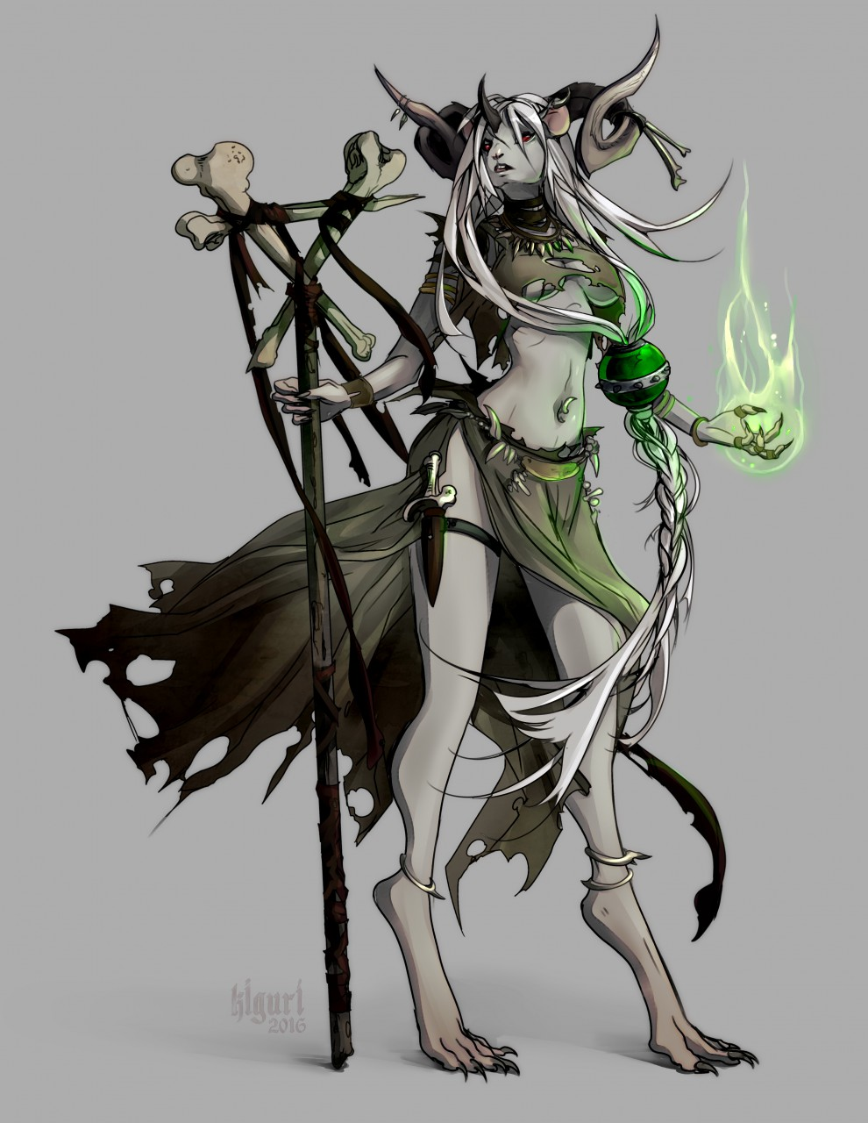
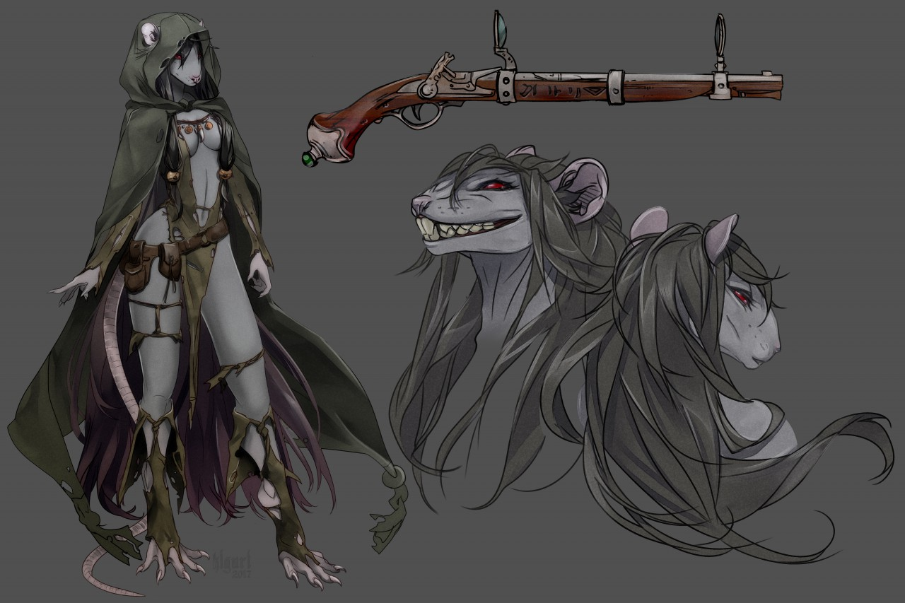
LOOK HOW CUTE THEY ARE

Slide 4
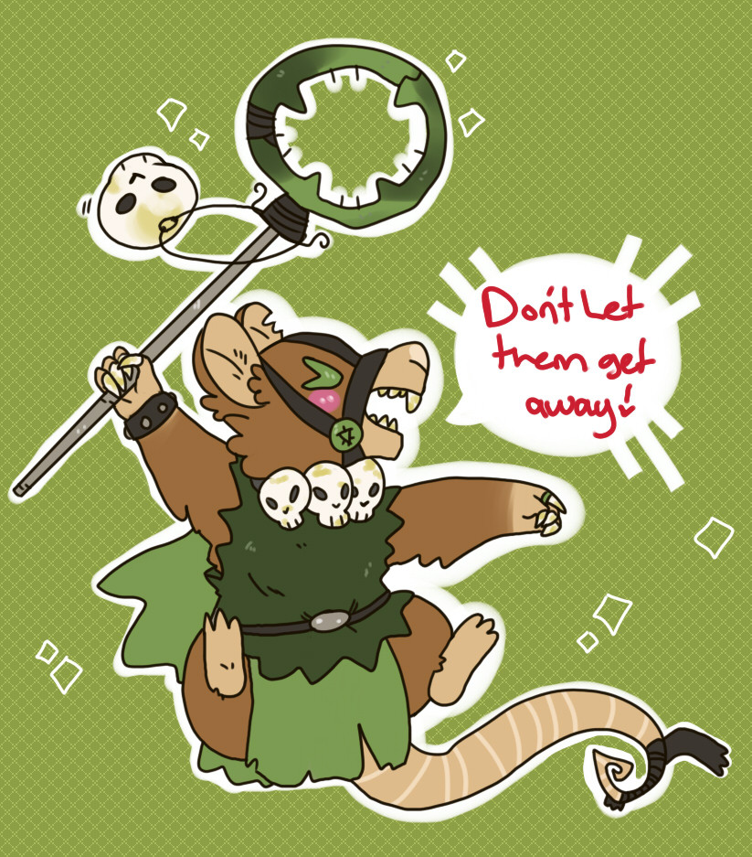
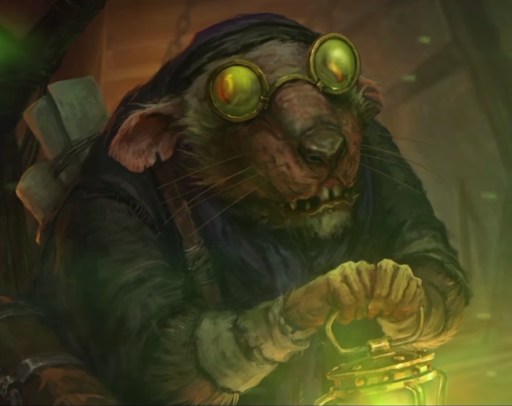
LOOK HOW FREAKING CUTE THEY ARE

Slide 5
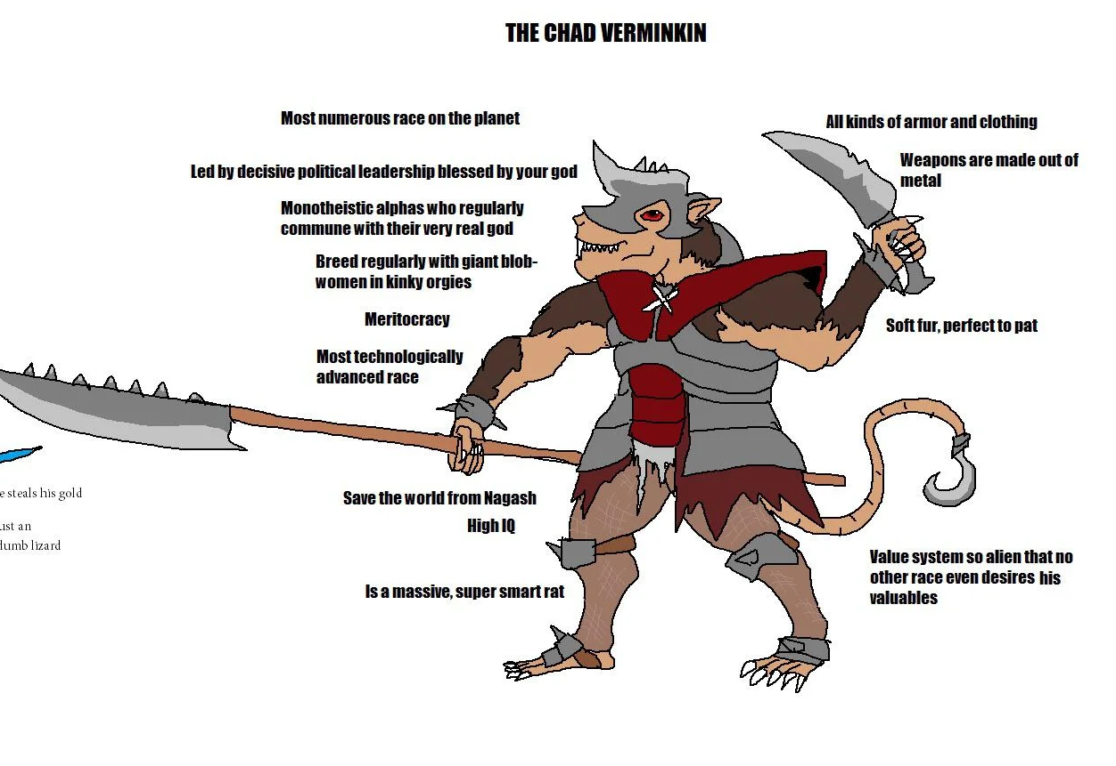
Memes

Slide 6
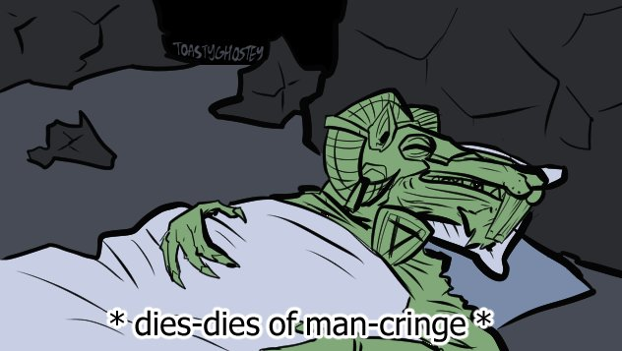

Slide 7
